Slide 1


Mechanical, Electrical, Plumbing
Construction works

Slide 2

Company Overview
  Cosmo Infrasolutions is a leader in providing integrated support from service to solutions to the industries in MEP work. It has been serving infrastructure companies for over two decades.
  Successfully executed various turnkey projects for all kind of Industries. As in Data Centres, Metro Projects, Railways TSS.
  Operating on PAN India Basis.
  Provides integrated works (Supply, Service & Solutions).
  ISO 45001,ISO 14001,ISO 9001 Certified.
  Highly skilled Professional with specialised teams.
  Timely delivery with quality & customer delight.

Slide 3
Areas of Expertise- MEP
Company Overview
Consultancy
Electrical & Civil Consultants
Designing
Efficient Layout , SLD & BOQ.
Project Management
Engineers & Contractors
Complete Turnkey Projects & Solutions
Electrical (HT/LT).
Fabrication
Civil Interior
SITC of Raised Floor
Vinyl Flooring
Fire Doors
Ceiling
Hot & Cold Containment
SITC of Fiber runner
Supply
Power Cable
Transformer
LED Lights, Cable Tray,
Industrial Sockets
Electrical Panels
Switchgears

Slide 4
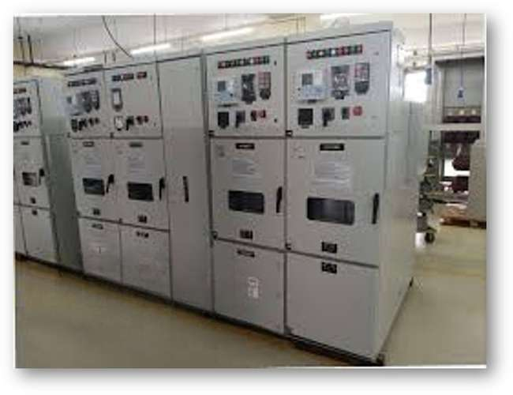
Service Offerings : H.T.
High Tension line work Up to 11 KV.
Overhead/underground Independent Feeder line.
Power Transformer/VCB / HT Panel / Metering Panels.
H.T Cable Joints with Heat Shrinkable Cable Jointing Kits.
G.O. Switch & D.O. Fuses / C.T. & P.T.
H.T XLPE Cables supply & Installation .
Chemical / Plate Earthing .
GI / Copper Strip supply & Installation.
Liasoning Work as per SEB Rules & regulations

Slide 5
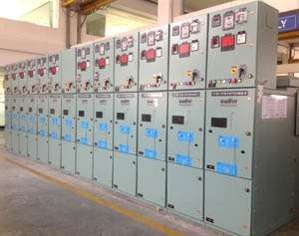
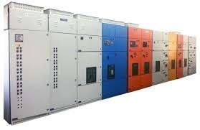
Service Offerings : L.T.
Distribution Panels
HVAC Panels
Firefighting Panels
Lighting Panels
Bus Bar Trunking System
Bus Duct
Rising Mains
L.T XLPE/PVC Cabling (Arm/Unarm./Flexible)
Cable Management System (thru. cable trays).
GI/Copper Earthing Strip.
Internal & External Wiring.
Power Distribution Boards (P.D.B), Lighting Distribution Boards (L.D.B).
Power Sockets.
Internal & External Lighting.
Lightening Protection System.
Fire Alarm/Suppression Systems

Slide 6
LV & HVAC
LV & HVAC
• PAC
• Structured Ducting
LV System
• Fire Suppression System
• WLD (Water Leak Detection)
• CCTV
• Access Control
• Rodent
• VESDA (Very Early Smoke Detection Apparatus)
• FAS (Fire Alarm System)

Slide 7
Expertise in Civil & Interior works
• Developed approximate 100000+ square feet area for switch room for Nxtra Data/airtel/VIL.
• Design based on input / requirements of clients.
• Supply, services, civil construction, interior fit-out & consultancy related works.
• In-house design & engineering team.
• Profession approach in monitoring.
• Cold/hot aisle containment for energy saving.
• Cost optimization solutions.

Slide 8
Snaps of real time projects executed by
COSMO

Slide 9
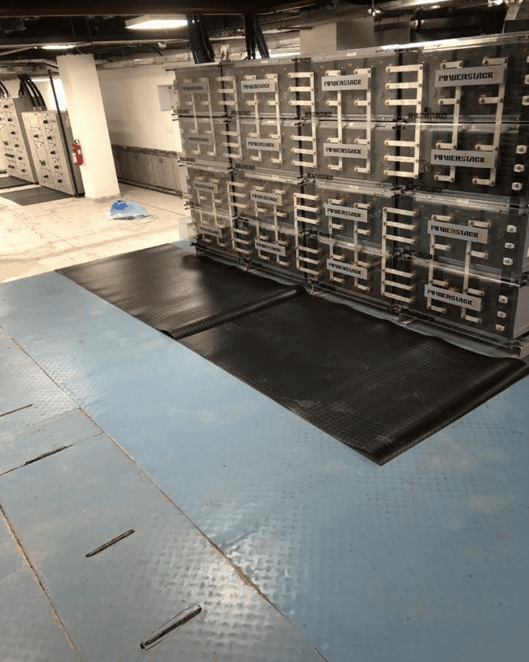
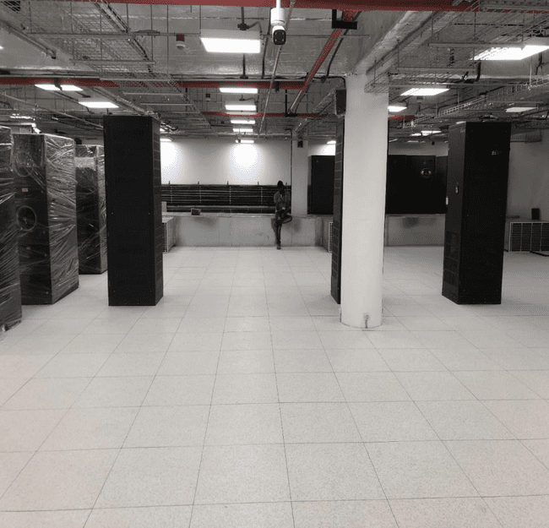
BB installation for SMPS (3060AH)
Light Fixtures and Placement

Slide 10
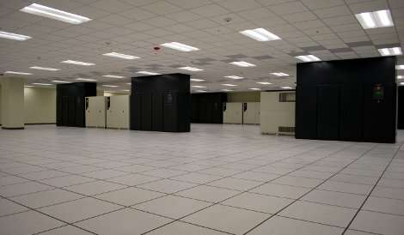
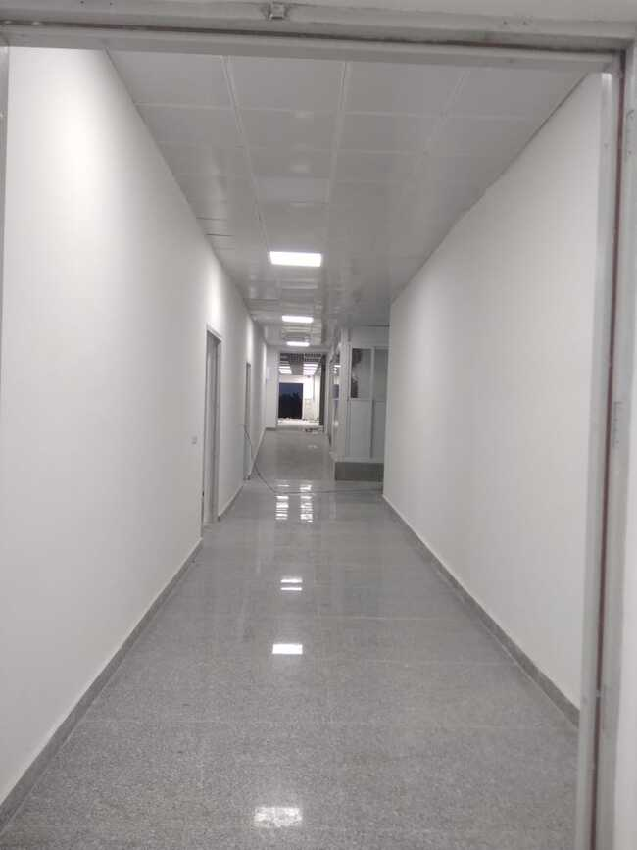
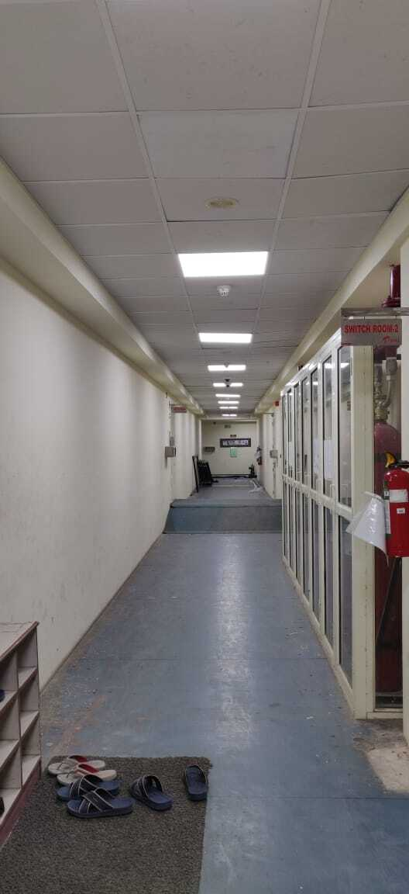
Flooring

Slide 11
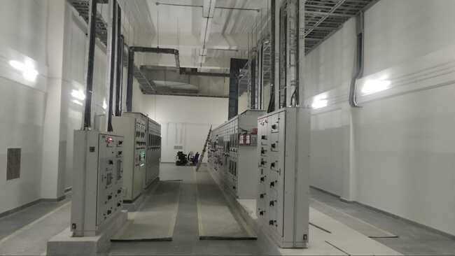
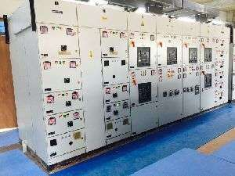
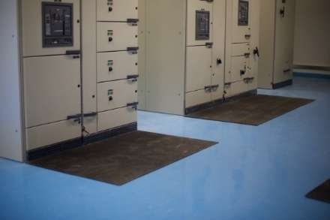
Panel Installation

Slide 12
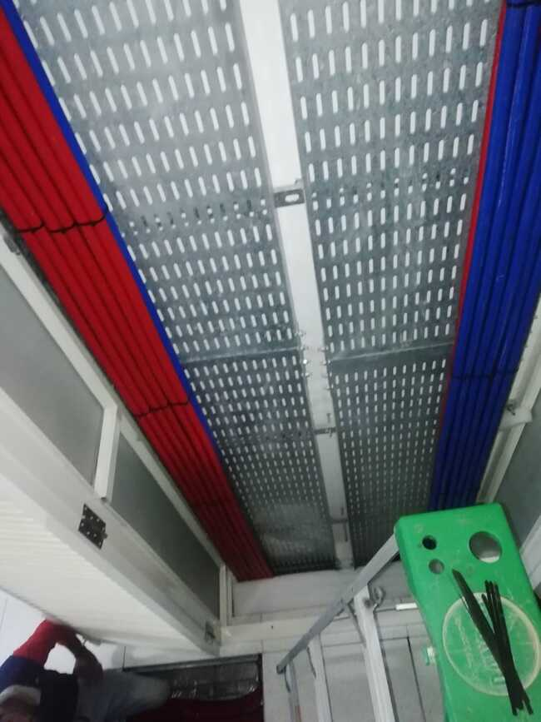
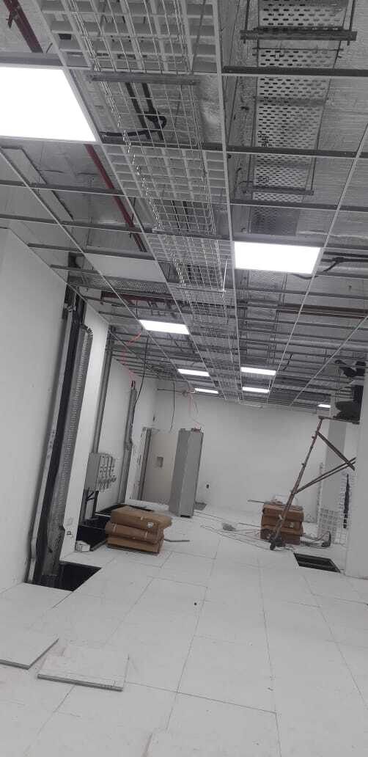
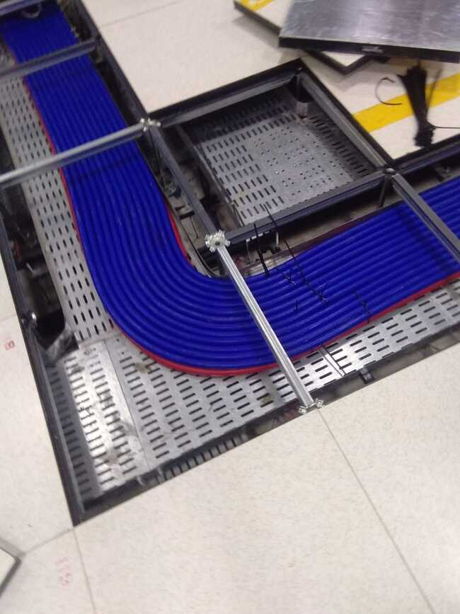
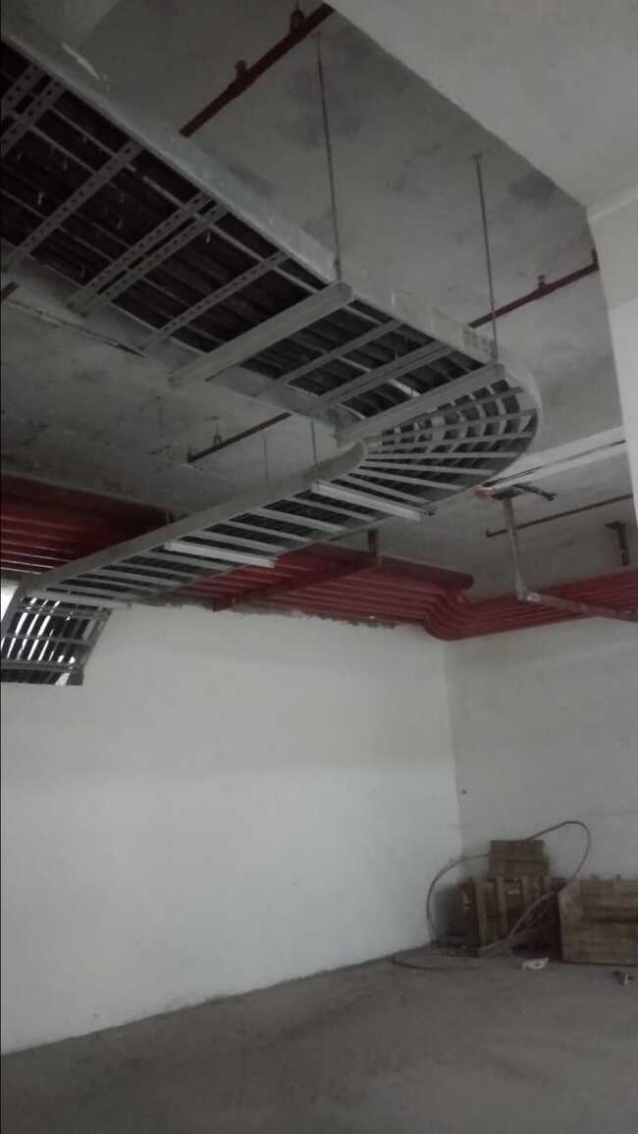
Cable Fixing
Cable Tray work

Slide 13





Health and Safety Policy
Permits to work
Workplace Supervision
Special authorization documentation
that ensures adequate risk has been
accessed for the process.
100% available for close supervisor at site
respective to Quality, Safety management,
work Progress and site management.
Personal Protective Equipment
EHS Awareness Programs
Used as per job specification and
requirements to protect from personal
injuries.
Organised parodically as National Safety
Week, Fire Safety Week , World
Environmental Day etc.
Safety Trainings & Skill Development
Program to be conduct according to TNI
(Training Need Identifications) and task specific .

Slide 14







Our Mission, Vision & Values
Mission : To provide our customers construction solutions using our expertise in the design.
Vision :
To become the leading Infrastructure Company, while delivering projects that consistently exceed international
standards and provide exceptional customer satisfaction.
To provide best technical infrastructure services by utilizing talented, skilful human resources as per highest customer
satisfaction and to maintain long term relationship.
To continuously deliver excellent value & innovative solutions to meet our clients' requirements.
Using modern principles and sophisticated technologies, Cosmo Infrasolutions envisions being the primary preference at
all times both nationally and globally, for their renowned excellence, quality, performance and reliability in all types of
constructions.
Values
Quality
& Innovation
Continuous
Improvement
Accountability
Safety

Slide 15
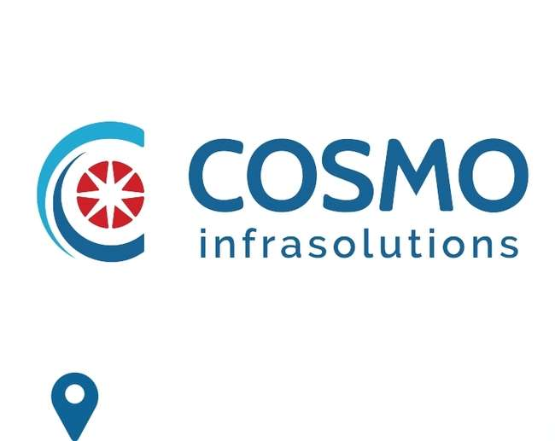



140, ShriGopal Nagar, Gopalpura Bye Pass Road,
Jaipur, Rajasthan 302015
+91 141 2500801
devendra.nama@cosmoinfrasolutions.com
naval.baheti@cosmoinfrasolutions.com
www.cosmoinfrasolutions.com

