Slide 1

Energy Management Solutions

Slide 2


Business Overview
Operating on PAN India Basis.
Provides integrated works (Supply, Service & Solutions).
ISO 45001,ISO 14001,ISO 9001 Certified.
Highly skilled Professional with specialised teams.
Timely delivery with quality & customer delight.

Slide 3
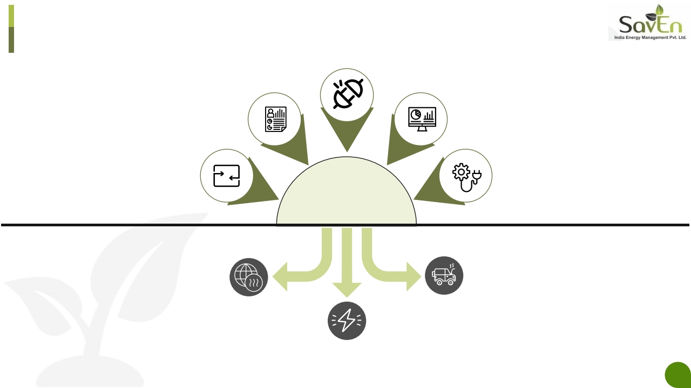
Problem that we solve
Connected Machines
Large volume
of accurate data
Data Analytics
Input and
Output Data
Energy Engineering
How to Reduce
Carbon Emission?
How to Reduce
Carbon Emission?
How to Reduce Energy
Consumption & Cost?

Slide 4
What we do?
Energy Conservation Consulting(Energy Audits)/ Remote Energy Analytics
AI Driven Energy Efficiency Projects in CapEx Model
AI Driven Energy Efficiency Projects in OpEx Financial Model
Smart Energy Monitoring System (Temp, Pressure, Flow, Water, Efficiency and Specific Energy
Consumption)

Slide 5

Our Solution – Four Step Process
Connect & Monitor Data
• Install Measurement
Devices
• Install SavEnIoTGateway
to transmit input energy
and output data to
SavEnIntelCore
Innovate & Engineer
Actions/Solutions
• Innovating and building
solutions to Improve
SEC by combining
power of data analytics
and Energy Engineering
• Solutions are of two
levels in this area-
• Level1 – Decisions
without CapEX
• Level2 – Decisions
needing CapEx
(Automation and Manual)
Simple Analytics,
Benchmark & Identify
Losses
• Benchmark SEC
• Identify losses (Supply
and Demand) and
quantify them.
• Identify Root Causes.
Implement The
Actions/Decisions
• Implement the solutions
to reduce the energy
consumption of
machines and reduce
losses.
• Finance the energy
saving projects (CapEx
and OpEx financial
model)

Slide 6
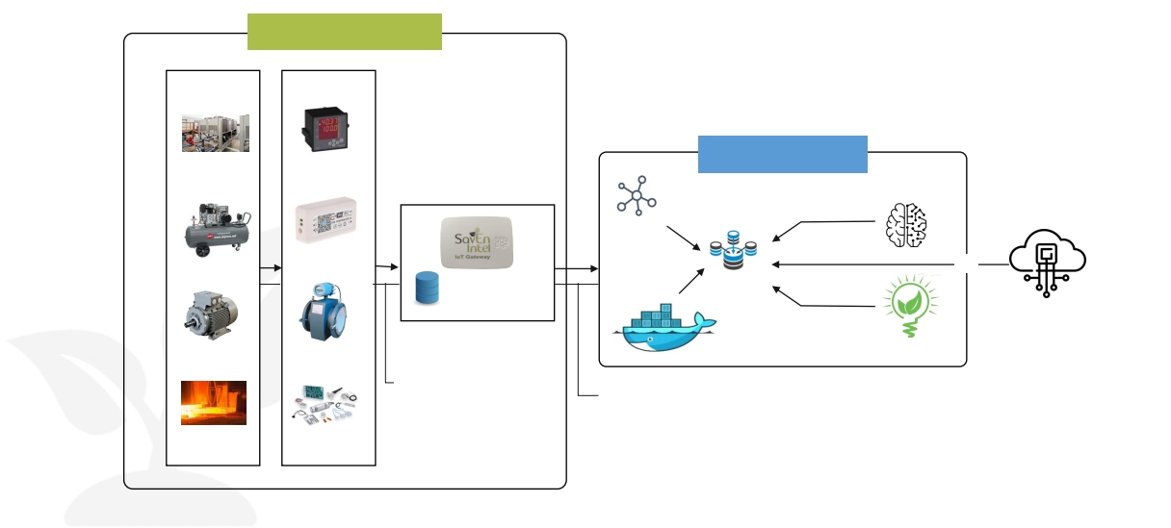
Intel Architecture
Customer Facilities
Device Simulator
Device Simulator
Chillers
Energy Meter
IOT Hub
Compressor
Smart Controller
Database
Database
Configuration
Motor
Flow Meter
Containers
Energy Engineering
Communication
Protocol
Furnaces
Sensors

Slide 7

Performance Dashboard
Number of ESCO & EPC Projects
38 & 22
Total ESCO Savings in INR
38 Cr+
Most Popular Payback Period
18 Months or 24% MIRR
ESCO Savings Percentage
35-55%%
22%
Projects Distribution-Facility Type
Industries
32%
Overall Savings
10 Cr+ kWh
100 Cr+ INR
Projects Distribution-Utility Type
Steam System 5%
Solar 5%
Machines
Air Compressors
16%
16%
Medium
Min
Max
81%
39
Contracts
39
Contracts
Buildings
68%
Air Conditioning
16%
Hot Water System
10%
Lighting, Pumping &
Blowers 32%
12

Slide 8
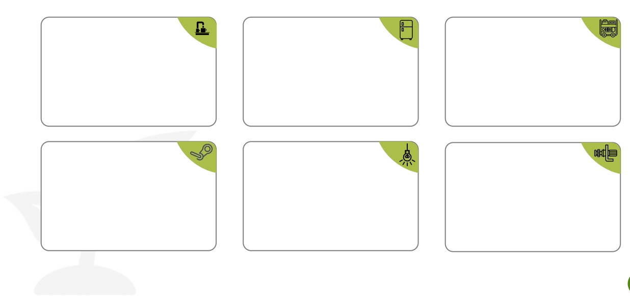
Performance Highlights
Hot Water System
Best Case – 55% Savings
Median – 45-50%
Payback – 20-24 Months
Steam System
Best Case – 35% Savings
Median – 30-35%
Payback – 15-28 Months
Chillers
Best Case – 38% Savings
Median – 30-35%
Payback – 18-30 Months
Lighting
Best Case – 80% Savings
Median – 45-65%
Payback – 8-24 Months
Air Compressor
Best Case – 50% Savings
Median – 35-45%
Payback – 18-24 Months
Pumping
Best Case – 62% Savings
Median – 35-55%
Payback – 14-20 Months
13

Slide 9





Health and Safety Policy
Permits to work
Workplace Supervision
Specific authorization to commence work post
assessment and mitigation of Risk / Safety Threat.
100% supervisor at site With respect to
Quality, Safety management,
work Progress and site management.
Personal Protective Equipment
EHS Awareness Programs
Used as per job specification and
requirements to ensure protection from any
personal injuries to the site team.
Organised parodically as National Safety
Week, Fire Safety Week , World
Environmental Day etc. to create awareness
in the employees.
Safety Trainings & Skill Development
Program to be conduct according to TNI
(Training Need Identifications) and task specific .

Slide 10
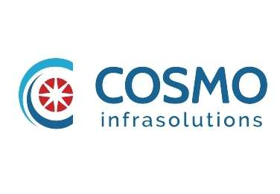







Our Mission, Vision & Values
Mission : To provide our customers construction solutions using our expertise in the design.
Vision :
To become the leading Infrastructure Company, while delivering projects that consistently exceed international
standards and provide exceptional customer satisfaction.
To provide best technical infrastructure services by utilizing talented, skilful human resources as per highest customer
satisfaction and to maintain long term relationship.
To continuously deliver excellent value & innovative solutions to meet our clients' requirements.
Using modern principles and sophisticated technologies, Cosmo Infrasolutions envisions being the primary preference at
all times both nationally and globally, for their renowned excellence, quality, performance and reliability in all types of
constructions.
Values
Quality
& Innovation
Continuous
Improvement
Accountability
Safety

Slide 11
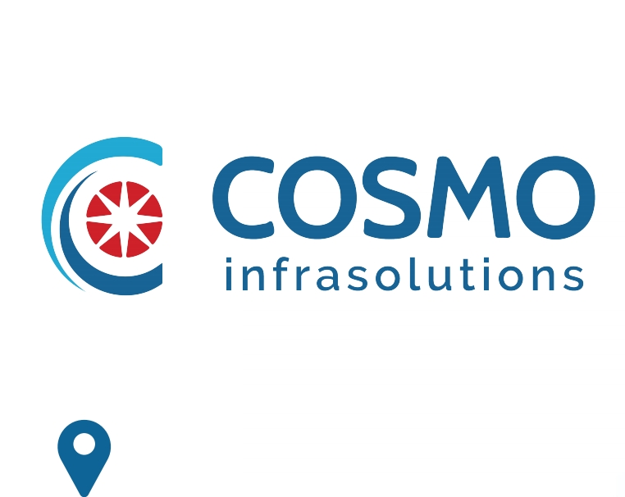



140, ShriGopal Nagar, Gopalpura Bye Pass Road,
Jaipur, Rajasthan 302015
+91 141 2500801
devendra.nama@cosmoinfrasolutions.com
naval.baheti@cosmoinfrasolutions.com
www.cosmoinfrasolutions.com

